Slide 1








Cyber Security
DU # 2101CS632
UNIT - 1
INTRODUCTION TO
CYBER SECURITY & CYBER CRIME
Anindya Sinha
Cyber Security Analyst
Samatrix Consulting Private Limited
anindya.sinha@samatrix.io
9952061704

Slide 2



STUXNET
Let’s start and understand cybersecurity with an example of a very well-crafted worm.
Stuxnet was a highly sophisticated computer worm discovered in 2010, and it stands out in the world of cybersecurity due to its unprecedented complexity and the nature of its target.
Anindya Sinha
#2101CS632  Unit 1 – Introduction to Cyber Security $ Cyber Crime
‹#›

Slide 3
STUXNET
Targeted Machines:
Stuxnet was designed to target industrial control systems, specifically those used in Iran's nuclear facilities. Its primary focus was to interfere with the programmable logic controllers (PLCs) that control machinery.
Modus Operandi:
The worm operated by exploiting multiple vulnerabilities, including zero-day vulnerabilities, in Windows operating systems. It used a combination of methods, including USB drives and network vulnerabilities, to spread and infect its targets.
Anindya Sinha
#2101CS632  Unit 1 – Introduction to Cyber Security $ Cyber Crime
‹#›

Slide 4
STUXNET
Digital Espionage:
Stuxnet was like a digital spy with a specific mission: to sabotage Iran's nuclear enrichment program. It achieved this by subtly manipulating the speed and behavior of centrifuges used in the enrichment process, causing physical damage to the machinery.
Unprecedented Complexity:
Stuxnet was notable for its complexity and sophistication. It employed multiple advanced techniques, including the use of stolen digital certificates, rootkit capabilities, and a two-stage attack strategy, making it one of the most sophisticated cyber weapons ever discovered.
Anindya Sinha
#2101CS632  Unit 1 – Introduction to Cyber Security $ Cyber Crime
‹#›

Slide 5

Definition of Cyber Security
Cybersecurity refers to the practice of protecting computer systems, networks, and digital assets from unauthorized access, attacks, damage, or theft.
It encompasses a range of technologies, processes, and practices designed to safeguard information, maintain the integrity of systems, and ensure the availability of digital resources.
Anindya Sinha
#2101CS632  Unit 1 – Introduction to Cyber Security $ Cyber Crime
‹#›

Slide 6
Example
Imagine you have an online account with a social media platform, and you want to ensure the security of your account information.
Strong Password:
Create a strong, unique password for your social media account
Two-Factor Authentication (2FA):
Enable two-factor authentication for an extra layer of security.
Regular Password Updates:
Periodically update your password to reduce the risk of unauthorized access.
Secure Connection (HTTPS):
Ensure you are using a secure connection when accessing your account. Look for "https://" in the URL, indicating that the connection is encrypted, making it harder for attackers to intercept your data.
Anindya Sinha
#2101CS632  Unit 1 – Introduction to Cyber Security $ Cyber Crime
‹#›

Slide 7

CYBER CRIMES
Section - 2

Slide 8

Definition of Cyber Crime
Cybercrime refers to criminal activities carried out through digital means, often targeting computers, networks, and online platforms. These activities are conducted with the intent of causing harm, financial loss, or stealing sensitive information.
Anindya Sinha
#2101CS632  Unit 1 – Introduction to Cyber Security $ Cyber Crime
‹#›

Slide 9
Types of Cyber Crimes
Malware Attacks:
Definition: Malicious software (malware) is designed to harm or exploit computer systems.
Example: Ransomware, such as the WannaCry attack, encrypts files on a victim's computer and demands a ransom for their release.
Phishing:
Definition: Deceptive attempts to trick individuals into divulging sensitive information like usernames, passwords, or financial details.
Example: A fraudulent email claiming to be from a bank requests the recipient to click on a link and enter login credentials on a fake website.
Identity Theft:
Definition: Unauthorized acquisition and use of someone's personal information for fraudulent purposes.
Example: Criminals use stolen identity information to open bank accounts.
Anindya Sinha
#2101CS632  Unit 1 – Introduction to Cyber Security $ Cyber Crime
‹#›

Slide 10
Types of Cyber Crimes
Online Scams:
Definition: Fraudulent schemes conducted online to deceive individuals for financial gain.
Example: Fake online auctions, where scammers collect money for items they don't intend to deliver.
Denial-of-Service (DoS) Attacks:
Definition: Overloading a computer system or network to make it unavailable to users.
Example: Flooding a website's servers with traffic to the point that legitimate users can't access the site.
Cyber Espionage:
Definition: Illegally accessing computer systems or networks to gather intelligence or sensitive information.
Example: State-sponsored hackers infiltrating another country's government systems to steal classified information.
Anindya Sinha
#2101CS632  Unit 1 – Introduction to Cyber Security $ Cyber Crime
‹#›

Slide 11
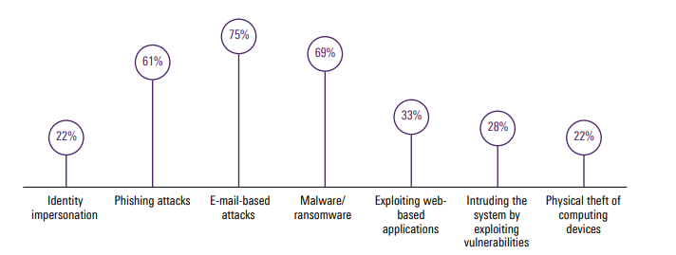
Types of Cyber Crimes
According to a Survey done by KPMG on the types of cyber crimes happening around the world, 75% were e-mail based.
Anindya Sinha
#2101CS632  Unit 1 – Introduction to Cyber Security $ Cyber Crime
‹#›

Slide 12
HACKING & ATTACK VECTORS
Section - 3

Slide 13
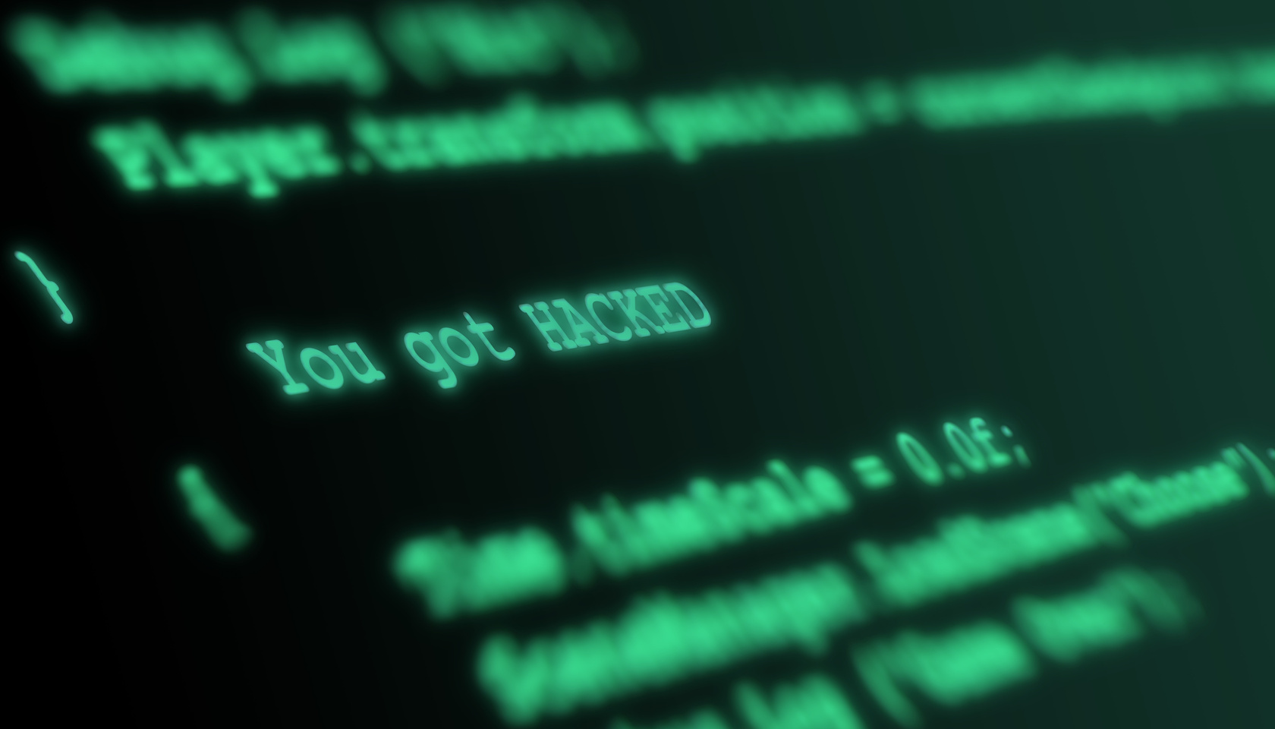
Example - Unauthorized Network Access
Example: Unauthorized Network Access
Scenario:
Imagine a computer network protecting sensitive corporate information. An unauthorized hacker aims to gain access to this network to steal valuable data or disrupt operations.
Anindya Sinha
#2101CS632  Unit 1 – Introduction to Cyber Security $ Cyber Crime
‹#›

Slide 14
Example - Unauthorized Network Access
Reconnaissance:
The hacker conducts research to gather information about the target network, such as IP addresses, domain names, and potential vulnerabilities.
Scanning:
Using various tools, the hacker scans the network to identify open ports, services, and potential entry points. This helps them understand the network's structure.
Exploitation:
The hacker exploits vulnerabilities found during scanning. This could involve using known software vulnerabilities, weak passwords, or social engineering tactics to gain unauthorized access.
Unauthorized Access:
Once a vulnerability is successfully exploited, the hacker gains access to the network. They may create backdoors or install malware for future access and control.
Privilege Escalation:
The hacker tries to gain higher levels of access, such as administrative privileges, to maximize control over the compromised network.
Anindya Sinha
#2101CS632  Unit 1 – Introduction to Cyber Security $ Cyber Crime
‹#›

Slide 15
Definition of Hacking
Hacking is the unauthorized or illegal access, manipulation, or compromise of computer systems, networks, or digital devices. Individuals who engage in hacking activities are often referred to as hackers. While some hackers use their skills for ethical and constructive purposes (ethical hacking or penetration testing), the term is commonly associated with those who exploit vulnerabilities for malicious reasons.
Anindya Sinha
#2101CS632  Unit 1 – Introduction to Cyber Security $ Cyber Crime
‹#›

Slide 16
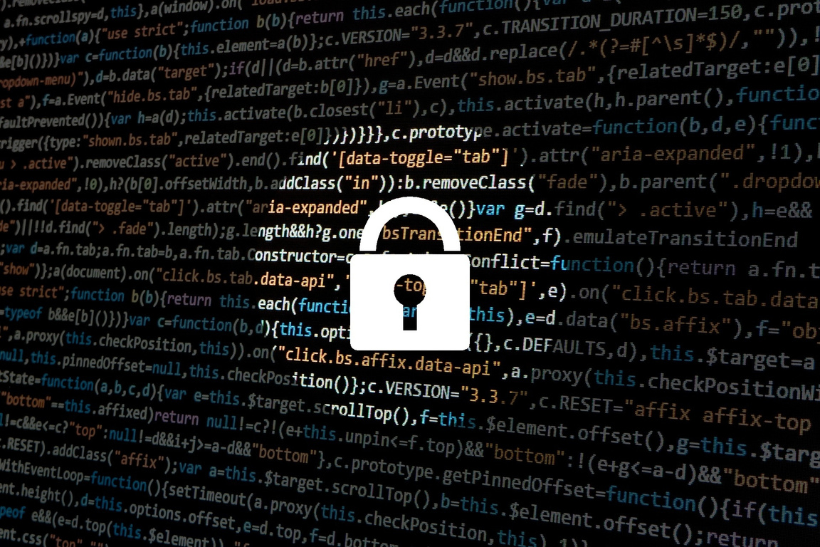
Case Study: SolarWinds Cyberattack (2020)
In December 2020, a massive cyberattack was revealed, targeting various U.S. government agencies and private companies. The attack leveraged a supply chain compromise through the SolarWinds Orion software, which is widely used for network monitoring.
Anindya Sinha
#2101CS632  Unit 1 – Introduction to Cyber Security $ Cyber Crime
‹#›

Slide 17
Case Study: SolarWinds Cyberattack (2020)
Initial Compromise:
Hackers compromised the software build system of SolarWinds, injecting malicious code into software updates. These tainted updates were then distributed to SolarWinds customers.
Scope of Impact:
The attack had a widespread impact, affecting numerous organizations, including government agencies, Fortune 500 companies, and technology firms. The compromised software allowed attackers to gain unauthorized access to networks.
Stealthy Operation:
The attackers demonstrated a high level of sophistication and patience. They remained undetected for several months, conducting reconnaissance, stealing credentials, and moving laterally within networks.
Attribution Challenges:
Attribution of the attack proved challenging. While widely believed to be state-sponsored, officially attributing the attack to a specific nation-state remains complex in the world of cybersecurity.
Data Exfiltration:
The attackers exfiltrated sensitive information, emphasizing the potential for espionage. The breach raised concerns about the compromise of classified government data and intellectual property.
Anindya Sinha
#2101CS632  Unit 1 – Introduction to Cyber Security $ Cyber Crime
‹#›

Slide 18
ATTACK VECTORS

Slide 19
What are Attack Vectors?
An Attack Vector is the pathway or means by which an attacker gains unauthorized access to a computer system, network, or application to exploit vulnerabilities and deliver a malicious payload. Understanding attack vectors is crucial for developing effective cybersecurity strategies.
Anindya Sinha
#2101CS632  Unit 1 – Introduction to Cyber Security $ Cyber Crime
‹#›

Slide 20
Common Attack Vectors
Phishing:
Description: Phishing attacks involve tricking individuals into revealing sensitive information by posing as a trustworthy entity.
Example: An attacker sends a fraudulent email, pretending to be a bank, and asks the recipient to click on a link to update their account information. The link leads to a fake website designed to steal login credentials.
Malware:
Description: Malicious software is designed to harm or exploit systems. Malware includes viruses, worms, trojans, ransomware, and spyware.
Example: A user unknowingly downloads a file from an email attachment that contains malware. Once opened, the malware infects the user's system and can steal sensitive data or disrupt operations.
Drive-By Downloads:
Description: Drive-by downloads occur when malware is automatically downloaded and installed on a user's device without their knowledge or consent.
Example: Visiting a compromised website that exploits vulnerabilities in the browser or plugins, leading to the automatic download and installation of malicious software.
Anindya Sinha
#2101CS632  Unit 1 – Introduction to Cyber Security $ Cyber Crime
‹#›

Slide 21
Common Attack Vectors
SQL Injection:
Description: SQL injection involves inserting malicious SQL code into input fields to manipulate a database.
Example: Exploiting a poorly protected web application by inputting malicious SQL code into a form field, allowing the attacker to retrieve or modify data in the database.
Cross-Site Scripting (XSS):
Description: XSS attacks involve injecting malicious scripts into trusted websites that are then executed by users' browsers.
Example: Posting a comment on a website with a script that, when viewed by other users, executes code on their browsers, potentially stealing cookies or session information.
Man-in-the-Middle (MitM) Attacks:
Description: MitM attacks occur when an attacker intercepts and manipulates communication between two parties.
Example: An attacker intercepts unencrypted Wi-Fi traffic between a user and a website, capturing sensitive information like login credentials or financial details.
Anindya Sinha
#2101CS632  Unit 1 – Introduction to Cyber Security $ Cyber Crime
‹#›

Slide 22
Common Attack Vectors
Brute Force Attacks:
Description: Brute force attacks involve systematically attempting multiple combinations of usernames and passwords until the correct credentials are found.
Example: Using automated tools to repeatedly guess login credentials until the correct combination allows unauthorized access to an account.
Social Engineering:
Description: Social engineering attacks manipulate individuals into divulging confidential information through psychological manipulation.
Example: Posing as a tech support representative, an attacker calls a user, claiming there's a security issue, and convinces them to provide login credentials.
Anindya Sinha
#2101CS632  Unit 1 – Introduction to Cyber Security $ Cyber Crime
‹#›

Slide 23
TRADITIONAL PROBLEMS ASSOCIATED WITH
COMPUTER CRIME
Section - 4

Slide 24

Traditional Problems assosciated with Computer Crimes
The physical environment that breeds computer crime is far different from traditional venues. In fact, the intangible nature of computer interaction and subsequent criminality poses significant questions for investigative agents. The lack of physical boundaries and the removal of traditional jurisdictional demarcations allow perpetrators to commit multinational crime with little fear (or potential) of judicial sanctions. For the first time, criminals can cross international boundaries without the use of passports or official documentation. Whereas traditional criminal activity required the physical presence of the perpetrators, cybercrime is facilitated by international connections that enable individuals to commit criminal activity in England while sitting in their offices in Alabama. In addition, electronic crime does not require an extensive array of equipment or tools.
Anindya Sinha
#2101CS632  Unit 1 – Introduction to Cyber Security $ Cyber Crime
‹#›

Slide 25
Traditional Problems assosciated with Computer Crimes
Perceived Insignificance, Stereotypes, and Incompetence
Investigators and administrators have displayed great reluctance to pursue computer criminals.
A lack of knowledge coupled with general apathy toward cyber criminality has resulted in an atmosphere of indifference.
Many stereotype computer criminals as nonthreatening, socially challenged individuals (i.e., nerds or geeks) and fail to see the insidious nature of computer crime.
In addition, those administrators and investigators who grudgingly admit the presence and danger of electronic crime tend to concentrate exclusively on child pornography, overlooking motivations and criminal behaviors apart from sexual gratification.
Even in situations where law enforcement authorities recognize the insidious nature of computer or cybercrime, many do not perceive themselves or others in their department to be competent to investigate such criminal activity.
Anindya Sinha
#2101CS632  Unit 1 – Introduction to Cyber Security $ Cyber Crime
‹#›

Slide 26
Traditional Problems assosciated with Computer Crimes
Lack of Reporting
The number of reported incidents handled by Carnegie-Mellon University’s Computer Emergency Response Team (CERT) has increased threefold, from 24,097 in 2006 to 72,065 in 2008. In their annual survey, CSO Magazine (in conjunction with the U.S. Secret Service, CERT, and Deloitte) reported that 58 percent of the organizations surveyed perceived themselves to be more prepared to prevent, detect, respond to, or recover from a cybercrime incident compared to the previous year.
However, only 56 percent of respondents actually had a plan for reporting and responding to a crime. In 2011, it was reported that over 75 percent of all insider intrusions were handled internally without notification of authorities.
Underreporting on the part of businesses and corporations may be attributed to a variety of reasons, but perhaps the most common are exposure to financial losses, data breach liabilities, damage to brand, regulatory issues, and loss of consumer confidence.
Contemporary society, characterized by increased reliance on paperless transactions, demands assurances that the company’s infrastructure is invulnerable and that confidential information remains inviolate.
Anindya Sinha
#2101CS632  Unit 1 – Introduction to Cyber Security $ Cyber Crime
‹#›

Slide 27
Traditional Problems assosciated with Computer Crimes
Lack of Resources
Computer intrusions have proven to be problematic within the corporate world, such institutions’ unwillingness or inability to effectively communicate with judicial authorities has led to an increase in computer crime.
Unfortunately, law enforcement and corporate entities desperately need to cooperate with one another.
Unlike their civil service counterparts, the business communities have the resources (both financial and legal) necessary to effectively combat computer crimes.
First, these companies, through their system administrators, have far more leeway in monitoring communications and system activities, and they have the ability to establish policies which enable wide-scale oversight.
Anindya Sinha
#2101CS632  Unit 1 – Introduction to Cyber Security $ Cyber Crime
‹#›

Slide 28
Traditional Problems assosciated with Computer Crimes
Lack of Resources
Computer intrusions have proven to be problematic within the corporate world, such institutions’ unwillingness or inability to effectively communicate with judicial authorities has led to an increase in computer crime.
Unfortunately, law enforcement and corporate entities desperately need to cooperate with one another.
Unlike their civil service counterparts, the business communities have the resources (both financial and legal) necessary to effectively combat computer crimes.
First, these companies, through their system administrators, have far more leeway in monitoring communications and system activities, and they have the ability to establish policies which enable wide-scale oversight.
Anindya Sinha
#2101CS632  Unit 1 – Introduction to Cyber Security $ Cyber Crime
‹#›

Slide 29
INCIDENT RESPONSE
Section - 5

Slide 30
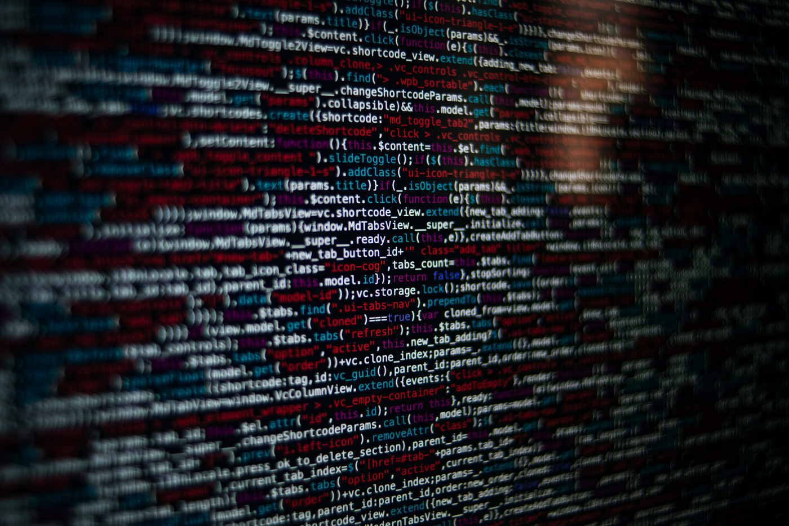
Incident Response
Incident response is a structured approach to addressing and managing the aftermath of a security incident or breach. The goal is to minimize damage and reduce recovery time and costs.
Anindya Sinha
#2101CS632  Unit 1 – Introduction to Cyber Security $ Cyber Crime
‹#›

Slide 31
Definition of Incident Response
Incident response refers to the structured and coordinated approach taken by an organization to manage and address the aftermath of a security incident. A security incident is any event that could potentially compromise the confidentiality, integrity, or availability of an organization's information assets.
Incident response aims to minimize damage, reduce recovery time and costs, and prevent similar incidents in the future.
Incident response is an essential component of a comprehensive cybersecurity strategy, helping organizations effectively navigate and mitigate the consequences of security incidents, ranging from minor anomalies to major breaches.
Anindya Sinha
#2101CS632  Unit 1 – Introduction to Cyber Security $ Cyber Crime
‹#›

Slide 32
Key Elements of Incident Response
Preparation:
Establishing an incident response plan, defining roles and responsibilities, and ensuring that the necessary tools and resources are available to respond effectively.
Identification:
Detecting and recognizing signs of a security incident, such as unusual network activity, unauthorized access, or system malfunctions.
Containment:
Taking immediate actions to prevent the incident from spreading and causing further damage. This may involve isolating affected systems, restricting network access, or shutting down compromised services.
Eradication:
Identifying the root cause of the incident and implementing measures to remove the threat or vulnerability. This step aims to eliminate the possibility of a recurrence.
Recovery:
Restoring affected systems and services to normal operation, ensuring that business operations can resume. This may involve restoring data from backups and applying security patches
Anindya Sinha
#2101CS632  Unit 1 – Introduction to Cyber Security $ Cyber Crime
‹#›

Slide 33
Key Elements of Incident Response
Lessons Learned:
Conducting a post-incident analysis to understand the incident's impact, identify areas for improvement, and update incident response procedures accordingly. This step is crucial for continuous improvement and strengthening overall security posture.
Communication:
Keeping stakeholders, including internal teams, external partners, and, if necessary, the public, informed about the incident, its impact, and the steps being taken to address it.
Documentation:
Thoroughly documenting the incident response process, including actions taken, outcomes, and lessons learned. This documentation is valuable for compliance, legal purposes, and future incident response planning.
Anindya Sinha
#2101CS632  Unit 1 – Introduction to Cyber Security $ Cyber Crime
‹#›

Slide 34
Incident Response Process
1. Preparation:
Develop an incident response plan (IRP) that outlines roles, responsibilities, and procedures.
Establish an incident response team (IRT) with members from various departments.
Define communication channels and establish relationships with external entities (law enforcement, vendors, etc.).
Acquire and deploy necessary tools for incident detection and response.
2. Identification:
Use monitoring tools and log analysis to detect abnormal or suspicious activities.
Employ intrusion detection systems (IDS) and security information and event management (SIEM) solutions to identify potential security incidents.
Monitor for indicators of compromise (IoCs) and anomalies in network and system behavior.
Anindya Sinha
#2101CS632  Unit 1 – Introduction to Cyber Security $ Cyber Crime
‹#›

Slide 35
Incident Response Process
3. Containment:
Isolate affected systems or networks to prevent the incident from spreading.
Disable compromised user accounts or services to limit further damage.
Implement network segmentation to quarantine compromised areas.
4. Eradication:
Investigate and determine the root cause of the incident.
Develop and apply solutions to remove the threat and address vulnerabilities.
Update security policies, configurations, and procedures to prevent similar incidents.
5. Recovery:
Restore affected systems and services to normal operation.
Validate the integrity of data and systems before returning them to production.
Apply patches, updates, and security measures to prevent a recurrence.
Anindya Sinha
#2101CS632  Unit 1 – Introduction to Cyber Security $ Cyber Crime
‹#›

Slide 36
Incident Response Process
6. Lessons Learned:
Conduct a thorough post-incident analysis to understand the incident's scope and impact.
Document lessons learned, including successes and areas for improvement.
Update the incident response plan, security policies, and procedures based on the analysis.
7. Communication:
Keep stakeholders informed about the incident, its impact, and the organization's response efforts.
Notify external entities, such as law enforcement, regulatory bodies, and affected customers, as required by legal and compliance obligations.
8. Documentation:
Maintain detailed documentation of the incident response process, actions taken, and outcomes.
Use documentation for compliance, legal purposes, and continuous improvement of incident response capabilities.
Anindya Sinha
#2101CS632  Unit 1 – Introduction to Cyber Security $ Cyber Crime
‹#›

Slide 37
Significance of Incident Response
Timely Mitigation:
Incident response allows organizations to respond promptly to security incidents, minimizing the potential impact and reducing the time it takes to detect and contain threats.
Risk Reduction:
By identifying and addressing security incidents, organizations can reduce the risk of data breaches, financial losses, and damage to their reputation.
Compliance Requirements:
Many industries and regulatory frameworks mandate incident response capabilities as part of compliance. Demonstrating an effective incident response process helps organizations meet legal and regulatory obligations.
Continuous Improvement:
The lessons learned from each incident contribute to continuous improvement in an organization's security posture. This iterative process enhances resilience against future threats.
Anindya Sinha
#2101CS632  Unit 1 – Introduction to Cyber Security $ Cyber Crime
‹#›

Slide 38
Significance of Incident Response
Customer Trust:
A well-executed incident response demonstrates to customers and stakeholders that an organization takes security seriously, fostering trust in the protection of their information.
Legal and Regulatory Compliance:
Compliance with data protection and privacy laws often requires organizations to have a robust incident response capability to handle and report security incidents appropriately.
Protection Against Reputation Damage:
An effective incident response helps mitigate the impact of a security incident on an organization's reputation by demonstrating transparency, accountability, and a commitment to security.
Anindya Sinha
#2101CS632  Unit 1 – Introduction to Cyber Security $ Cyber Crime
‹#›

Slide 39
RECOGNISING & DEFINING COMPUTER CRIMES
Section - 5

Slide 40
Recognizing Computer Crime
Computer crimes can have varying levels of severity, ranging from relatively minor offenses to serious and sophisticated attacks that result in significant financial, operational, or personal harm.
Unusual Network Traffic:
Monitor network traffic for anomalies, spikes, or patterns that deviate from normal usage. Sudden increases in data transfer or communication with known malicious IP addresses could indicate a security incident.
Unauthorized Access:
Identify instances of unauthorized access to computer systems or networks. This may involve someone gaining entry through stolen credentials, exploiting vulnerabilities, or using unauthorized methods to access data.
Unexplained System Behavior:
Be alert to unexpected behavior in computer systems or applications. This could include unusual system crashes, slowdowns, or unexplained changes in system settings.
Malicious Software Detection:
Use antivirus and anti-malware tools to detect and remove malicious software. Frequent or sudden detections of malware, viruses, or other malicious code may indicate a computer crime.
Anindya Sinha
#2101CS632  Unit 1 – Introduction to Cyber Security $ Cyber Crime
‹#›

Slide 41
Recognizing Computer Crime
Phishing Attempts:
Educate users to recognize phishing attempts. Be wary of unsolicited emails, messages, or links that prompt users to provide sensitive information. Phishing is a common method for unauthorized access.
Data Anomalies:
Monitor for unusual patterns in data access or changes. Unexpected modifications to sensitive data, unauthorized copying, or mass downloads could signify a data breach or unauthorized use.
Unauthorized Account Access:
Watch for signs of unauthorized access to user accounts. Multiple failed login attempts, especially if they involve multiple accounts, may indicate a brute force attack or an attempt to compromise credentials.
Denial-of-Service (DoS) Attacks:
Recognize signs of a denial-of-service attack, such as a sudden increase in traffic that overwhelms a network or system, leading to service disruption.
Insider Threats:
Be aware of potential insider threats. Employees with malicious intent or those who unwittingly compromise security can pose a significant risk.
Anindya Sinha
#2101CS632  Unit 1 – Introduction to Cyber Security $ Cyber Crime
‹#›

Slide 42
Recognizing Computer Crime
Unexplained Financial Transactions:
Monitor financial transactions for any unexplained or unauthorized activities. This is crucial in identifying computer crimes related to financial fraud or unauthorized fund transfers.
Monitoring Logs and Auditing:
Regularly review system logs and conduct security audits. Analyzing logs can reveal suspicious activities, such as repeated login attempts, privilege escalation, or unauthorized system changes.
Security Alerts:
Pay attention to security alerts generated by intrusion detection systems, firewalls, or other security tools. These alerts can provide early indications of potential security incidents.
Anindya Sinha
#2101CS632  Unit 1 – Introduction to Cyber Security $ Cyber Crime
‹#›

Slide 43
DEFINING COMPUTER CRIMES

Slide 44
Defining Computer Crime
Involvement of Digital Technology:
Determine whether the crime involves the use of digital technology, such as computers, networks, the internet, or electronic devices. Cybercrimes are characterized by their reliance on digital tools for planning, execution, or facilitation.
Electronic Evidence:
Examine whether electronic evidence is central to the investigation. Cybercrimes often leave a digital footprint, and the analysis of electronic evidence, such as log files, metadata, or digital forensics, is crucial in understanding the crime.
Use of the Internet:
Check whether the crime relies on the internet as a medium for communication, planning, or execution. Cybercrimes often involve online platforms, social media, or communication channels to facilitate illegal activities.
Unauthorized Access or Intrusion:
Determine whether the crime involves unauthorized access to computer systems, networks, or electronic devices. Activities like hacking, phishing, or exploiting vulnerabilities often characterize cybercrimes.
Anindya Sinha
#2101CS632  Unit 1 – Introduction to Cyber Security $ Cyber Crime
‹#›

Slide 45
Defining Computer Crime
Data Manipulation or Theft:
Assess whether the crime includes the manipulation, theft, or unauthorized access to digital data. Cybercrimes frequently target sensitive information, financial data, personal records, or intellectual property.
Malicious Software:
Check for the use of malicious software (malware) in the commission of the crime. Cybercriminals often deploy viruses, trojans, ransomware, or other types of malware to compromise systems and data.
Online Fraud and Financial Crimes:
Identify whether the crime involves fraudulent activities conducted online, such as phishing scams, identity theft, credit card fraud, or other financial crimes facilitated through digital means.
Electronic Communication Interception:
Determine whether the crime involves the interception or unauthorized monitoring of electronic communications. This may include wiretapping, email interception, or eavesdropping on digital conversations.
Anindya Sinha
#2101CS632  Unit 1 – Introduction to Cyber Security $ Cyber Crime
‹#›

Slide 46
Defining Computer Crime
Denial-of-Service Attacks:
Check for the use of denial-of-service (DoS) or distributed denial-of-service (DDoS) attacks aimed at disrupting digital services, websites, or online platforms.
Cyberbullying or Online Harassment:
Assess whether the crime involves harassment, threats, or intimidation conducted online, such as cyberbullying, stalking, or online hate crimes.
Social Engineering:
Determine if the crime relies on social engineering techniques to manipulate individuals into divulging confidential information, such as passwords or financial details.
Anindya Sinha
#2101CS632  Unit 1 – Introduction to Cyber Security $ Cyber Crime
‹#›

Slide 47
CONTAMINANTS & DESTRUCTION OF DATA
Section - 6

Slide 48

What are Contaminants and Destruction of Data?
Contamination and destruction of data refer to intentional or unintentional actions that compromise the integrity, availability, and reliability of digital information. These actions can result in the loss, corruption, or manipulation of data, leading to significant consequences for individuals, organizations, and systems.
Anindya Sinha
#2101CS632  Unit 1 – Introduction to Cyber Security $ Cyber Crime
‹#›

Slide 49
Contaminants of Data
Contaminants in the context of data refer to unwanted or harmful substances that introduce errors, alterations, or impurities into digital information, compromising its reliability and accuracy.
Examples:
Malware: Malicious software, such as viruses, worms, trojans, or ransomware, that infects systems and can manipulate or destroy data.
Data-corrupting Code: Specific lines of code intentionally designed to corrupt or modify data, leading to data integrity issues.
Anindya Sinha
#2101CS632  Unit 1 – Introduction to Cyber Security $ Cyber Crime
‹#›

Slide 50
Contaminants of Data
Malware and Viruses:
Description: Malicious software, such as viruses, worms, trojans, and ransomware, can contaminate and destroy data on infected systems.
Impact: Loss of data integrity, unauthorized access, encryption of files (in the case of ransomware), and potential damage to system functionality.
Data Corruption:
Description: Unintended changes to data that render it inaccurate, incomplete, or unusable.
Causes: Hardware failures, software bugs, or other issues during data storage, processing, or transmission.
Impact: Loss of data integrity, leading to incorrect decisions, financial losses, or operational disruptions.
Physical Damage to Storage Media:
Description: Physical harm to storage devices, such as hard drives, SSDs, or servers, resulting in the loss of stored data.
Causes: Accidental damage, natural disasters, or intentional destruction.
Impact: Permanent loss of data, potential financial and operational setbacks.
Anindya Sinha
#2101CS632  Unit 1 – Introduction to Cyber Security $ Cyber Crime
‹#›

Slide 51
Contaminants of Data
Accidental Deletion:
Description: Unintentional removal of files or data by users.
Causes: Human error, misconfiguration, or lack of proper data management practices.
Impact: Loss of critical information, especially if there are no backup mechanisms in place.
Anindya Sinha
#2101CS632  Unit 1 – Introduction to Cyber Security $ Cyber Crime
‹#›

Slide 52
Destruction of Data
Destruction of data involves the intentional or unintentional deletion, erasure, or loss of digital information, rendering it irrecoverable or unusable.
Examples:
Data Deletion: Deliberate removal of files, folders, or entire datasets by individuals with unauthorized access or malicious intent.
Data Overwriting: Overwriting existing data with random or useless information, making the original data unrecoverable.
Physical Destruction: Damaging the storage medium (e.g., hard drives, SSDs) physically, rendering stored data inaccessible.
Anindya Sinha
#2101CS632  Unit 1 – Introduction to Cyber Security $ Cyber Crime
‹#›

Slide 53
Destruction of Data
Insider Threats:
Description: Intentional actions by employees or individuals with insider access to compromise or destroy data.
Motivations: Disgruntled employees, industrial espionage, or financial gain.
Impact: Loss of sensitive information, intellectual property theft, and potential legal consequences.
Denial-of-Service (DoS) Attacks:
Description: Overloading systems, networks, or websites to make them unavailable to legitimate users.
Impact: Disruption of services, rendering data inaccessible, and potential financial losses.
Data Tampering:
Description: Unauthorized alteration of data to manipulate its content for malicious purposes.
Motivations: Fraud, misinformation, or attempting to compromise the integrity of records.
Impact: Compromised data integrity, leading to incorrect decisions or actions based on tampered information.
Data Exfiltration:
Description: Unauthorized copying or transfer of data from a system or network to an external location.
Motivations: Espionage, intellectual property theft, or preparing for a ransomware attack.
Impact: Loss of sensitive information, potential legal and regulatory consequences.
Anindya Sinha
#2101CS632  Unit 1 – Introduction to Cyber Security $ Cyber Crime
‹#›

Slide 54
Destruction of Data
Environmental Factors:
Description: Natural disasters, fires, floods, or other environmental events that can physically damage data storage facilities.
Impact: Permanent loss of data, disruption of services, and potential business continuity challenges.
Software Bugs and Glitches:
Description: Programming errors or glitches that result in unintended consequences, including data corruption or loss.
Impact: Unpredictable system behavior, potential data integrity issues, and operational disruptions.
Cyber Espionage:
Description: Covert activities by state-sponsored or malicious actors to infiltrate systems and steal sensitive data.
Motivations: Gathering intelligence, stealing trade secrets, or compromising national security.
Impact: Loss of sensitive information, potential economic and geopolitical consequences.
Mitigating the risks associated with data contamination and destruction involves implementing robust cybersecurity measures, regular data backups, access controls, and disaster recovery plans. Additionally, user education and awareness programs can help prevent accidental data loss.
Anindya Sinha
#2101CS632  Unit 1 – Introduction to Cyber Security $ Cyber Crime
‹#›

Slide 55
CIA TRIAD & IAAA
Section - 7

Slide 56

What are CIA Triad & IAAA?
The CIA Triad and IAAA principles are necessary for building a robust and effective information security framework. They provide a foundation for protecting sensitive information, managing risks, complying with legal requirements, and establishing a secure and trustworthy computing environment. Organizations that implement these principles are better equipped to safeguard their assets against a wide range of cyber threats.
CONFIDENTIALITY
CIA TRIAD
INTEGRITY
AVAILABILITY
Anindya Sinha
#2101CS632  Unit 1 – Introduction to Cyber Security $ Cyber Crime
‹#›

Slide 57
Why are these principles necessary(CIA TRIAD)?
Comprehensive Security Coverage:
Confidentiality: Protecting sensitive information from unauthorized access ensures privacy and prevents unauthorized disclosure.
Integrity: Ensuring data integrity prevents unauthorized or accidental alterations, maintaining the accuracy and reliability of information.
Availability: Guaranteeing availability ensures that authorized users can access information and resources when needed.
Balanced Security Approach:
The CIA Triad provides a balanced approach to security. By addressing confidentiality, integrity, and availability, organizations can develop comprehensive security strategies that cover a broad spectrum of threats.
Anindya Sinha
#2101CS632  Unit 1 – Introduction to Cyber Security $ Cyber Crime
‹#›

Slide 58
Why are these principles necessary(CIA TRIAD)?
Risk Management:
Understanding the CIA Triad helps organizations assess and manage risks effectively. It allows them to prioritize security measures based on the criticality of data and the potential impact of security incidents.
Framework for Security Discussions:
The CIA Triad serves as a common language for security discussions. It facilitates communication among cybersecurity professionals, stakeholders, and decision-makers when planning, implementing, and evaluating security controls.
Anindya Sinha
#2101CS632  Unit 1 – Introduction to Cyber Security $ Cyber Crime
‹#›

Slide 59
Why are these principles necessary(IAAA)?
Access Control and Authorization:
Identification: Establishing the identity of users or entities seeking access is the first step in controlling access to information and resources.
Authentication: Verifying the identity of users ensures that only authorized individuals gain access to specific systems or data.
Authorization: Defining and enforcing access policies based on authenticated identities ensures that users have the appropriate level of access.
Auditability and Accountability:
Auditability: Monitoring and logging activities provide a record for auditing, helping organizations detect and respond to security incidents.
Accountability: Knowing who accessed what, when, and why ensures accountability. It discourages malicious activities and helps attribute actions to specific individuals or entities.
Anindya Sinha
#2101CS632  Unit 1 – Introduction to Cyber Security $ Cyber Crime
‹#›

Slide 60
Why are these principles necessary(IAAA)?
Legal and Compliance Requirements:
IAAA principles are essential for meeting legal and regulatory requirements related to information security. Compliance with regulations often mandates the implementation of strong access controls, authentication practices, and auditing capabilities.
Data Security:
IAAA principles contribute to the overall security of data. They ensure that access is granted based on a need-to-know basis, reducing the risk of unauthorized access, data breaches, and data manipulation.
Risk Mitigation:
Proper identification, authentication, authorization, and accountability measures contribute to risk mitigation by preventing unauthorized access and activities that could lead to data breaches, financial losses, or reputational damage.
Anindya Sinha
#2101CS632  Unit 1 – Introduction to Cyber Security $ Cyber Crime
‹#›

Slide 61
CIA TRIAD
Confidentiality:
Definition: Ensuring that information is only accessible to authorized individuals or systems.
Example: Encrypting sensitive data such as customer information, financial records, or intellectual property. Only individuals with the appropriate decryption keys can access the confidential information.
Integrity:
Definition: Guaranteeing the accuracy and trustworthiness of information, preventing unauthorized or accidental modifications.
Example: Using hash functions to verify the integrity of files. A user calculates the hash value of a file, and if it matches the original hash value, the file hasn't been altered.
Availability:
Definition: Ensuring that authorized users have timely and reliable access to information and resources.
Example: Implementing redundant servers and load balancing to ensure that a website remains available even if one server fails. This prevents denial-of-service (DoS) attacks from disrupting the availability of the service.
Anindya Sinha
#2101CS632  Unit 1 – Introduction to Cyber Security $ Cyber Crime
‹#›

Slide 62
IAAA
Identification:
Definition: Verifying the identity of users, systems, or entities trying to access resources.
Example: When logging into a computer system, a user provides a username or an employee ID. This is the identification phase, indicating who is trying to access the system.
Authentication:
Definition: Confirming the claimed identity through credentials such as passwords, biometrics, or security tokens.
Example: After entering a username, the user provides a password. The system compares the entered password with the stored one to authenticate the user.
Authorization:
Definition: Granting or denying access rights and permissions based on the authenticated identity.
Example: After a user is authenticated, the system determines what actions the user is allowed to perform.
Accountability:
Definition: Tracking and logging user activities to ensure responsibility and traceability.
Example: In a network, logging mechanisms record who accessed what resources and when. In case of a security incident, these logs are crucial for identifying the source and impact of the incident.
Anindya Sinha
#2101CS632  Unit 1 – Introduction to Cyber Security $ Cyber Crime
‹#›

Slide 63
Scenario: Online Banking System (CIA TRIAD)
Confidentiality:
Scenario: A user logs in to their online banking account to check their transaction history.
Explanation: The user's financial data is confidential. Encryption is applied to protect the transmission of data between the user's device and the bank's server, ensuring that only the authorized user can access their sensitive financial information.
Integrity:
Scenario: The user initiates a fund transfer from their account to another account.
Explanation: Hash functions are used to ensure the integrity of the transaction. The system verifies that the fund transfer request has not been altered during transmission or processing, maintaining the accuracy and reliability of the transaction data.
Availability:
Scenario: Many users simultaneously access the online banking system.
Explanation: Redundant servers and load balancing are implemented to ensure the availability of the online banking system. This prevents disruptions due to heavy user traffic or potential denial-of-service attacks, ensuring that users can access the system when needed.
Anindya Sinha
#2101CS632  Unit 1 – Introduction to Cyber Security $ Cyber Crime
‹#›

Slide 64
Scenario: Corporate File Sharing System (IAAA)
Identification:
Scenario: An employee logs in to the corporate file-sharing platform.
Explanation: The employee provides a unique username or employee ID, identifying themselves to the system.
Authentication:
Scenario: After entering the username, the employee provides a password.
Explanation: The system compares the entered password with the stored one to authenticate the employee's identity.
Authorization:
Scenario: The employee attempts to access a restricted folder with confidential documents.
Explanation: The system checks the employee's role and permissions. If authorized, access to the restricted folder is granted; otherwise, access is denied.
Accountability:
Scenario: An employee downloads a sensitive document.
Explanation: The system logs the download activity, recording who accessed the document, when, and for what purpose. This audit trail is essential for accountability and compliance with data protection regulations.
Anindya Sinha
#2101CS632  Unit 1 – Introduction to Cyber Security $ Cyber Crime
‹#›

Slide 65
I came, I saw, I Conquered

